Slide 1
AIHA: Leading the Charge to Protect Worker Health & Safety
AIHA-NCS Dinner Meeting
March 19, 2019

Slide 2
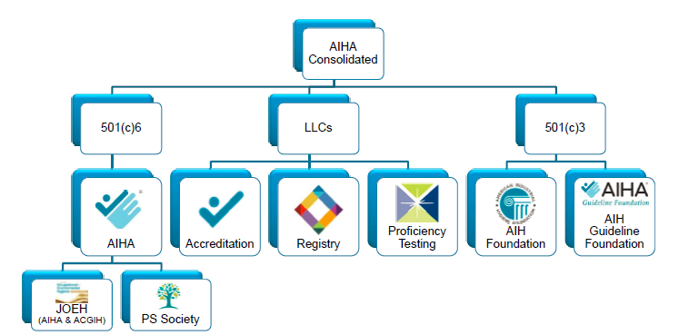
AIHA Organization Structure
Notes:
The AIHA National organization has many different business units. On the left side of the screen, we have the 8500 individuals that make up the membership (this is 501c6 under the US tax code). Within this, AIHA publishes the Journal of Occupational and Environmental Health and also manages an allied organization called the Product Stewardship Society (which has its own annual meeting and a distribution of about 3000 product steward professionals).
In the middle of the slide there are three Limited Liability Corporations – lab accreditation, registry programs (certification programs for professionals such as asbestos analysts and safety data sheet authors), and proficiency testing (to provide test samples to labs to ensure they are competent in what they do).
Finally, on the right side you see two 501c3 foundations. The AIHA Foundation awards scholarships to students studying occupational hygiene in college. The Guideline Foundation helps develop global standards as well as what are called emergency response planning guides for firefighters and other first responders.

Slide 3
AIHA Strategic Plan (2019-21)
Our Mission - Empowering those who apply scientific knowledge to protect all workers from occupational hazards
Our Vision – A world where all workers are healthy and safe
Notes:
Every organization should have a Strategic Plan, which provides structure and direction to every-day operations. AIHA is pleased to present its new plan which was recently approved by the Board of Directors. This slide shows our new Mission & Vision statements.

Slide 4
Domains/Success Statements
Community: AIHA will foster networking, communication, engagement and interaction in our membership and among our professional communities, and work towards achieving common goals.
Awareness: AIHA will promote the practice of IH to increase awareness of its value and to sustain the future of our organization and profession.
Advancement / Dissemination of Knowledge: AIHA will explore, develop and deliver cutting-edge educational resources to advance the profession of industrial hygiene.
Integrity of IH Practice: AIHA will identify, develop and maintain avenues to achieve excellence in standards of IH practice.
Advocacy: AIHA will advance public policies that protect the profession and foster worker health and safety.
Notes:
And, this slide shows the 5 domains of practice, which reflect all the various business units of the AIHA enterprise, including the LLCs (LAP, PAT, Registries which are reflected in #4), the Product Stewardship Society (reflected in #1), and the two Foundations (reflective in #3). Each domain has an associated success statement (shown here), as well as supporting strategic objectives and strategies (not shown). We also have adopted a series of metrics (what does success mean across each area) that the staff and Board will keep track of over time. To download the complete plan, visit www.aiha.org and look under the Governance section.

Slide 5

COMMUNITY
Notes:
We’ll now begin delving into each of the 5 domains, starting with Community.

Slide 6






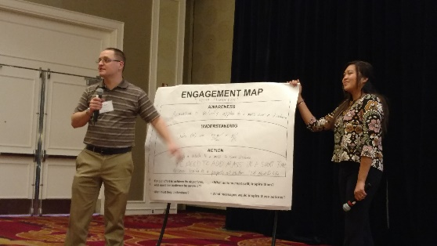
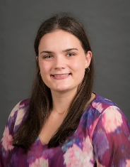
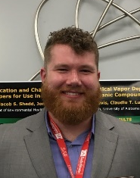
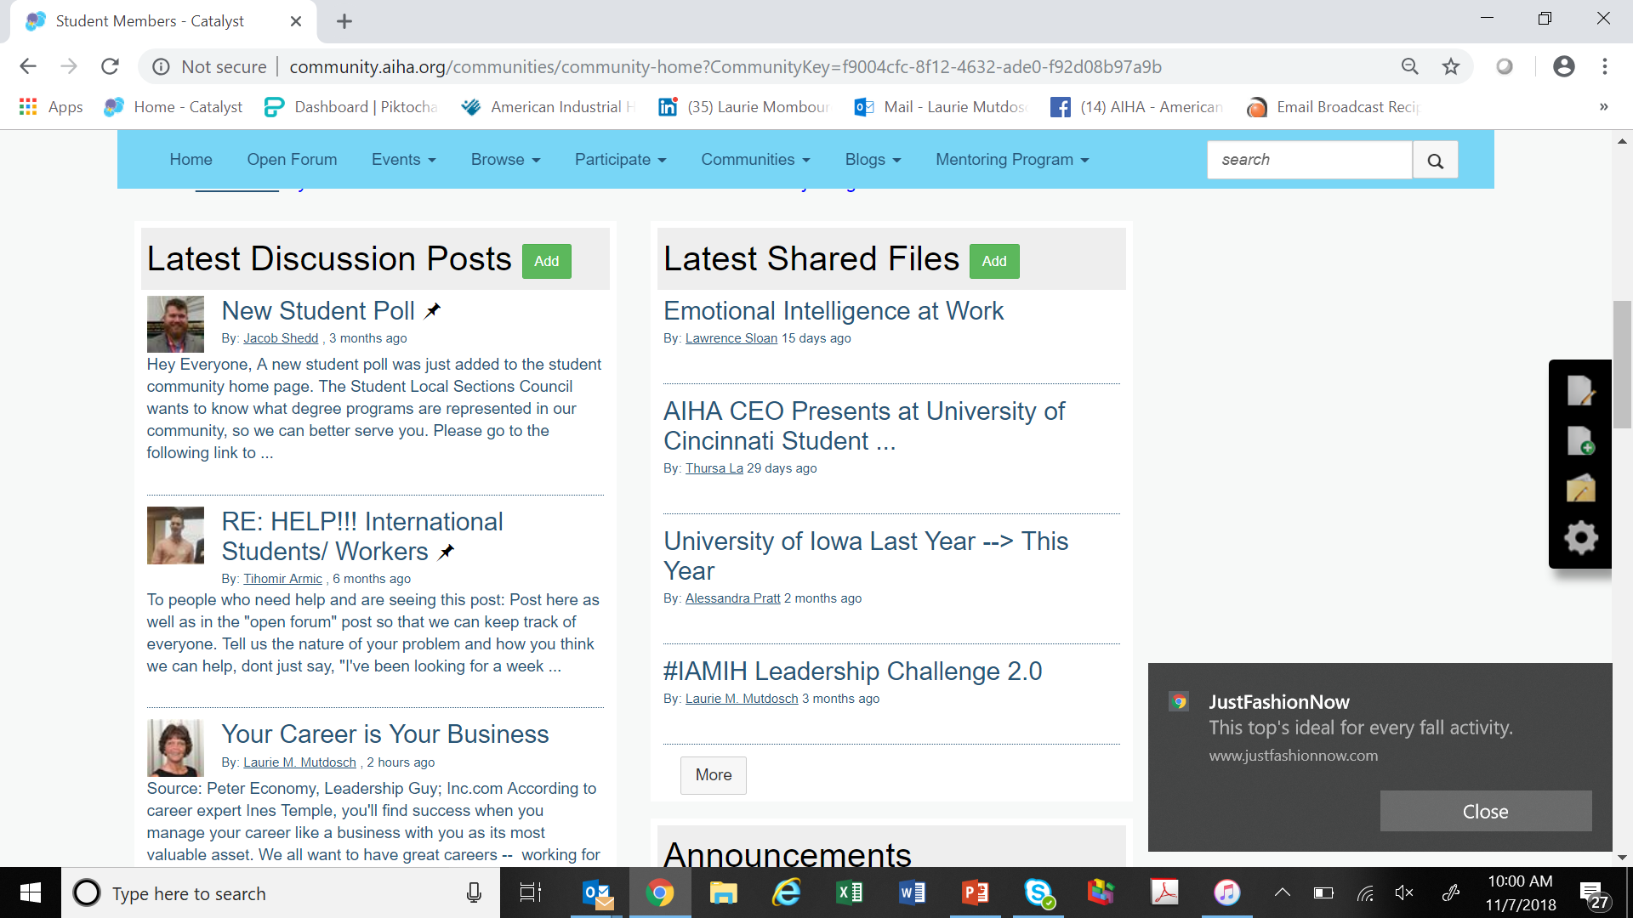
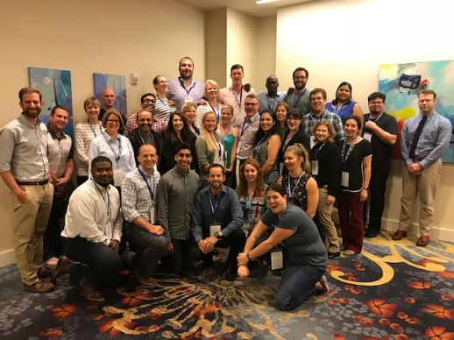
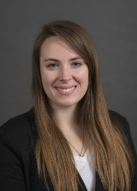
.
Notes:
Earlier this year, AIHA launched a new online community program called Catalyst. Virtual rooms are set up for close to 100 groups, including our student members only room. AIHA has been pleasantly surprised by how actively members are using it.

Slide 7
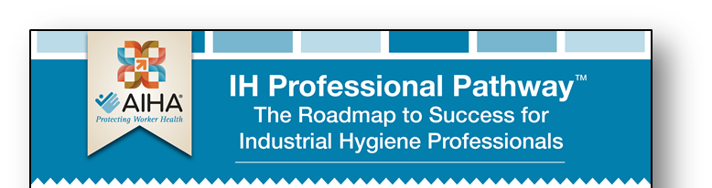





Each level of an IH professional's career can be described by the relevant technical, management, and leadership skills.
Student/Intern
Young Professional
Mid-Career
Professional
Senior Professional
Emeritus Professional
Notes:
AIHA has developed what’s called IH Professional Pathway program, which is designed to help professionals navigate their careers from being a student all the way through emeritus, a nice way of saying retired. For each stage there are technical, management and leadership suggestions to pursue. A new e-guide will soon be available.

Slide 8

AWARENESS
Notes:
Next…awareness.

Slide 9
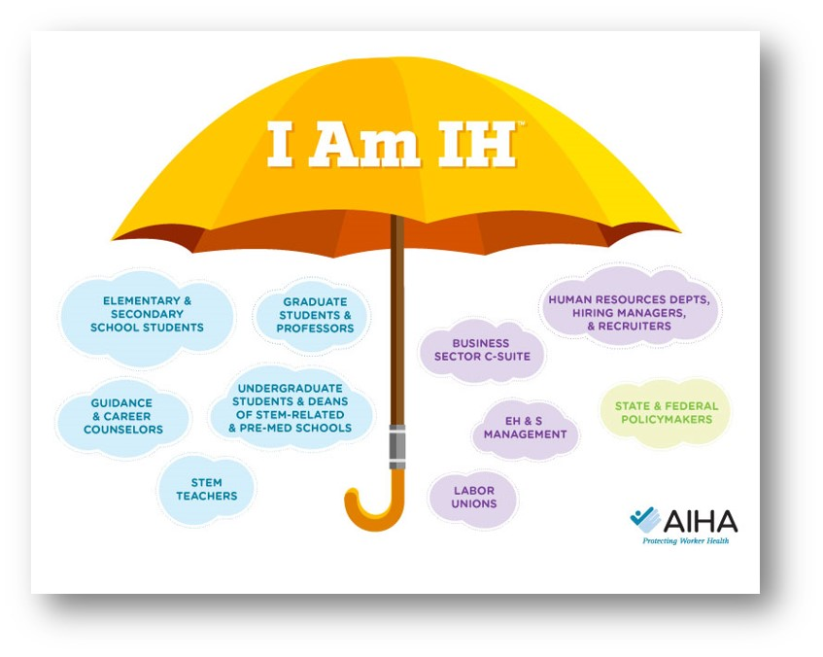
Notes:
This umbrella figure represents the various audiences that are stakeholders. Starting with secondary school students who may be working at their first job, science teachers who have a responsibility to educate our children about the real world (and dangers in the workplace), through EHS management, and all the way up to the business C-suite (the executives who need to be better educated on the business value for what we do).

Slide 10
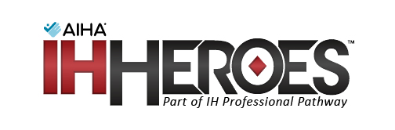
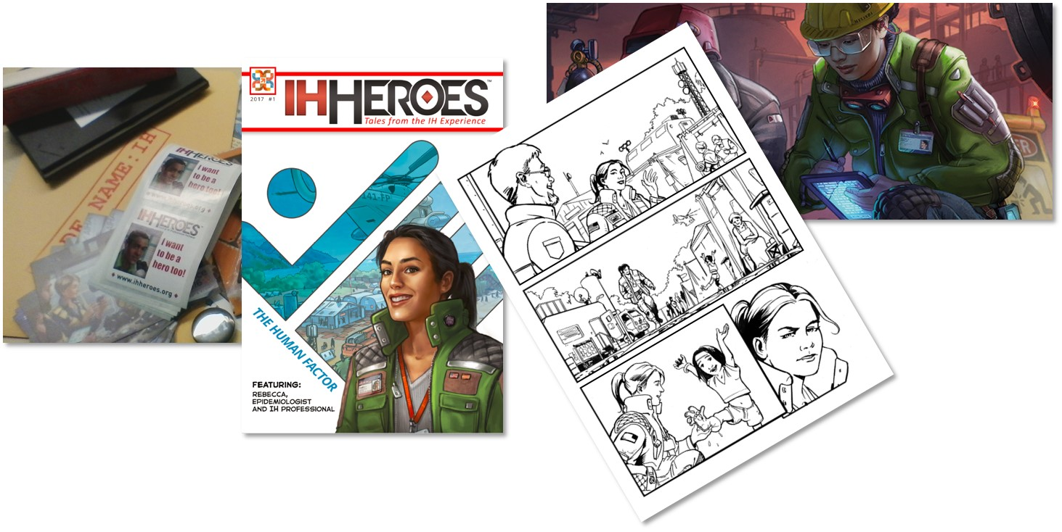
Public Awareness Outreach
https://www.aiha.org/about-ih/IH-Heroes/Pages/home.aspx
Notes:
The “IH Heroes” is a series of comic books aimed at younger students (generally upper elementary and middle school aged). They tell the story of an occupational hygienist as an everyday hero.

Slide 11
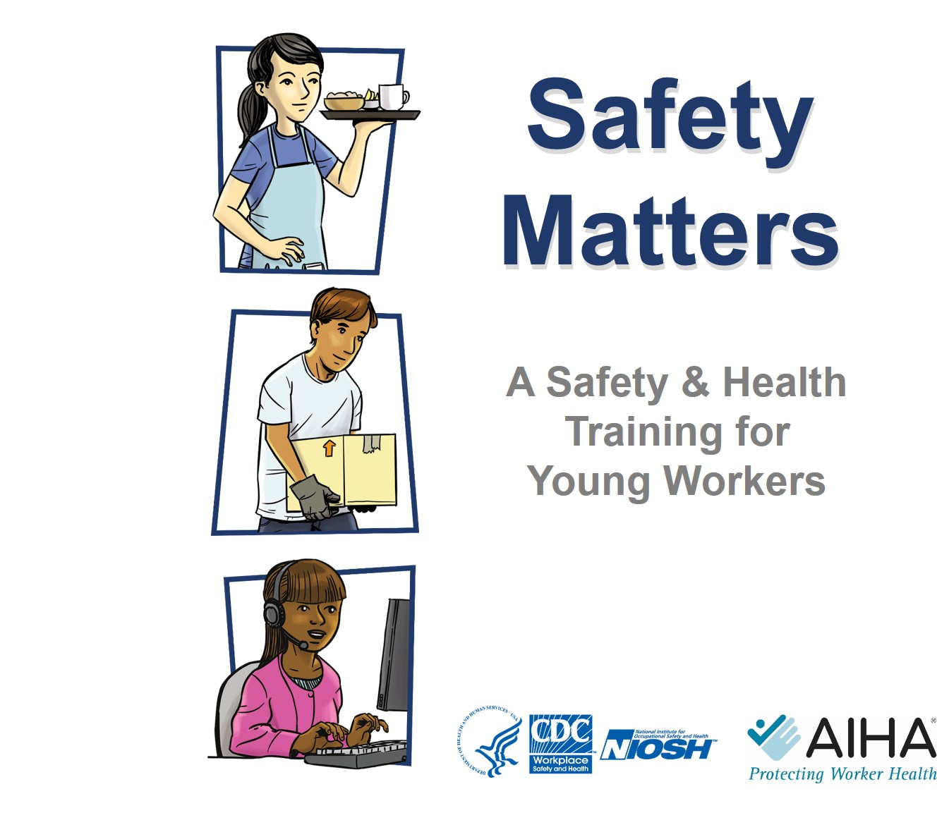
Public Awareness Outreach
https://www.aiha.org/get-involved/SafetyMattersCenter/Pages/default.aspx
Notes:
And, as noted earlier -- Safety Matters, a collaborative effort developed by NIOSH and AIHA. This program is designed for high school students to create an awareness about the importance of safety their first jobs. It is based on the more comprehensive Youth @ Work Safety program developed by NIOSH. It has been taught in schools around the US for several years and can be covered in as little as one hour in the classroom.

Slide 12

KNOWLEDGE

Slide 13

Mission: To advance the profession by awarding scholarships for funding education and professional development in industrial hygiene and related disciplines.
For 2018, 47 students were selected to receive $116,950 of scholarship funding with scholarships ranging from $1,000 to $6,800.
In 2019, AIHF expanded their eligibility pool to students studying IH and/or OEHS from non-qualifying IH programs. A school administrator must complete a separate application justifying why their program should be considered eligible for an AIHF scholarship
The 2019 - 2020 AIHF Application cycle runs from October-January.
.
Notes:
Since 1982, AIHF has distributed nearly $2 million to 680 students studying industrial hygiene and related disciplines at 54 different schools and universities. These scholarships have enabled talented students to complete their education and have encouraged the most promising scholars to enter or remain in the industrial hygiene profession.
Open to full or part time students enrolled in the following program:
A graduate or undergraduate degree program that is fully ABET-accredited under the Industrial Hygiene Program Criteria or under the Environmental, Health, and Safety Program Criteria.
A graduate degree program fully accredited by CEPH as a program with a concentration in Environmental Health.
An Industrial Hygiene or similarly named program offered at a NIOSH-ERC university.
An industrial hygiene or similarly named program at one of the following Canadian institutions: McGill University, University of British Columbia, Université de Montréal, Université du Québec à Trois-Rivières (UQTR), or University of​ Toronto.

Slide 14
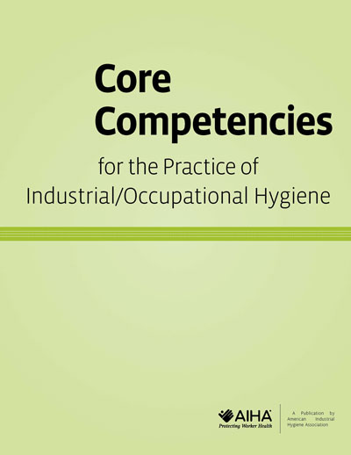
Core Competencies for the Practice of Industrial-Occupational Hygiene (Revised 2018)
Outlines the essential knowledge, skills, and abilities that an IH/OH working at different levels of practice should possess.​​​
Applicable to several audiences:
  Students ​gain an understanding of industrial hygiene and prepare for a career in IH/OH.
  Academic programs may ​reference the document to design, review, and update curricula.
  Employers establish career paths by setting expectations for knowledge and skill development assigned to IH/OH positions within their respective organizations.
  Individual practitioners at all stages of their careers find it helpful as a guide to further their professional and career development.
Get your free digital copy at:
https://www.aiha.org/publications-and-resources/Pages/Core-Competencies-for-the-Practice-of-Industrial-Occupational-Hygiene.aspx

Slide 15
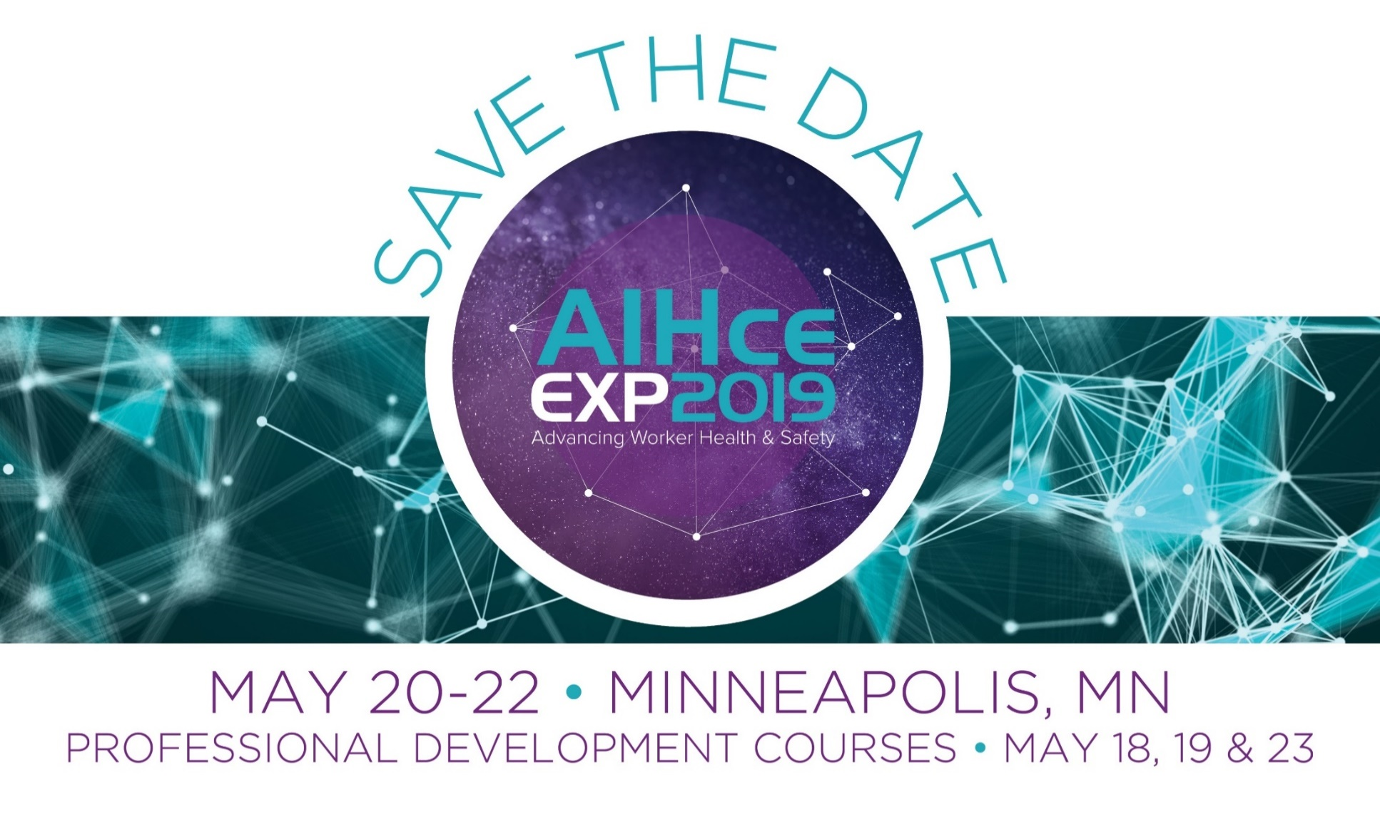
2019 SPECIAL ALERT: Student Members will get 10% off any PDC registration!
https://www.aihce2019.org/Attend/ImAttending/Pages/For-Students.aspx
Notes:
AIHce EXP is our flagship conference, held every spring. In 2019 we’ll be heading to Minneapolis where some 4500 attendees will meet to learn, network with colleagues, and foster new relationships. The event includes an exposition with dedicated show times. AIHce’s education meets the highest-quality educational standards and guidelines, providing opportunities for OEHS professionals to broaden their knowledge, enhance technical competence, and gain practical tools and skills. Attendees participate for the purpose of discovering new ideas and solutions they can apply in their own practice.
The call for submissions has now closed and the conference planning committee is reviewing abstracts. Student poster submissions are still open.

Slide 16
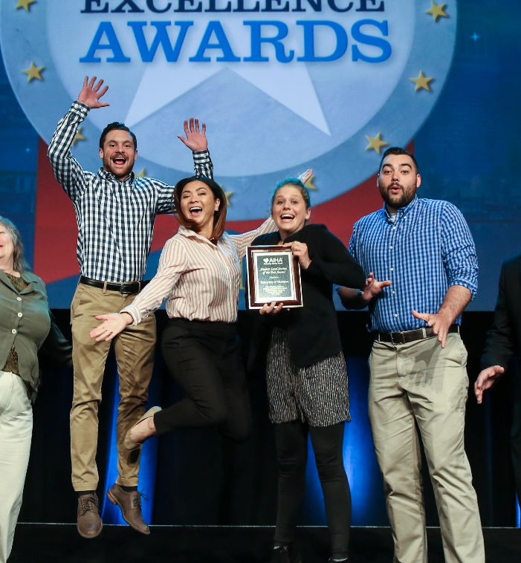



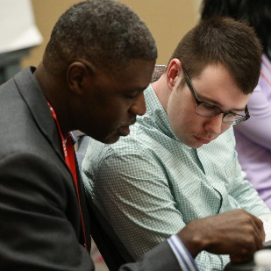
Student AIHce Opportunities
NEW! Academic Track
  NEW! Back to the Community Project
  NEW! Mentor Lunch-n-Learn
  NEW! IAMIH Student Connection Lounge
  Special Student-Only Conference Rates & Offers
  Student Local Section Council
Student Poster Presentations and Awards
CareerAdvantage & Resource HUB
PAL First-Timers AIHce Program
Student Reception
AIHF Scholarship & Fun Run
Technical & Professionals Committees
Notes:
New features for students at AIHce this year!

Slide 17
Educational Initiatives / Academic Track for Students at AIHceEXP 2019
Perspectives on Preparation for the CIH Exam - Version 14.0
The Ideal Internship Experience, Student and Mentor Perspectives
Building Strong Relationships by Enhancing Mentor-Mentee Synergy: Helpful Do's & Don'ts and Effective Use of Self-Awareness Strategies Using Catalyst
If I Knew Then What I Know Now - Lessons for Your Career Path
Who Moved my Sampling Pump
Notes:
Various topics to be presented in the new educational track at AIHce 2019

Slide 18
Educational Initiatives / Academic Track for Students at AIHceEXP 2019
Student Poster Sessions Author Attend Time
Best in Show Students Poster Presentations
University of Minnesota Student Presentations
UCLA Student Presentations
University of Central Missouri Student Presentations
University of Iowa Student Presentations
OUHSC Student Presentations

Slide 19
2019 eLearning
New Online Courses
  OHTA W201 Basic Principles of Occupational Hygiene – March 2019
  Occupational Exposure Assessment (OEA), Level 1 Certificate Program – March-April 2019 (Students/Early Career)
  CIH Prep Online – March 2019
Notes:
In the area of online learning, AIHA is developing some new courses.
The first is based on a fundamentals course currently offered by an organization called OHTA. AIHA is taking the OHTA classroom version and converting into an online course, with plans to promote it to allied audiences such as occupational hygiene practitioners (who may not have a full college degree) and EHS generalists.
The second is a special course for students/early career professionals in area of OEA – to help build skills and confidence in eventually sitting for CIH exam

Slide 20

Exposure Decision Assessment (Students/Early Career)
The goal of this program is to improve the accuracy and efficiency of exposure assessment decisions that can be made when using statistical analysis tools.
Lists you alongside individuals recognized for ongoing personnel training, quality assurance, and demonstration of competency in rendering exposure decisions
Improves the overall quality of your management of workplace exposures
Encourages a platform of continuous improvement, essential to collaboration and sharing of best practices.​
Best of all, it’s FREE!

Slide 21
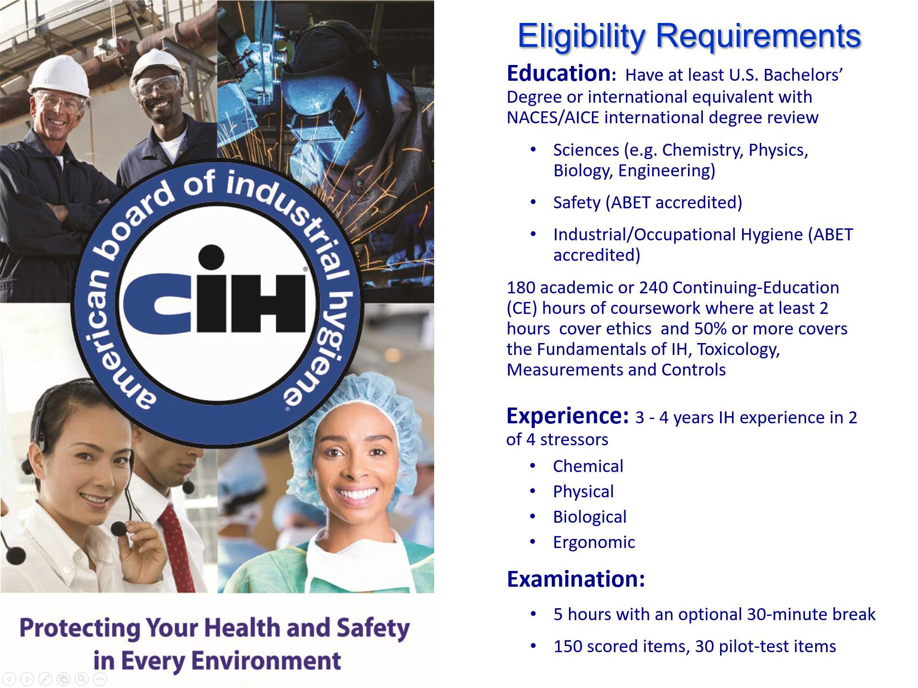

Slide 22

Industrial Hygiene Practice
Foundation – Fundamentals – Application – Content Priorities
Hierarchy of Controls
Elimination | Substitution |  | Engineering / Ventilation Controls | Administrative Controls |  | Personal Protective Equipment
OHS Management: Risk Assessment, Risk Management, and Risk Communication
Exposure Assessment: Workplace, Workforce, Occupational Agent Information
Workplace Hazards, Advanced Science, and Evaluation Techniques
Air Sampling and Instrumental Analysis |  | Biological Hazards
Chemical Hazards |  | Community Exposure |  |  | Biostatistics and Epidemiology
Ergonomics |  | Fatigue Management |  |  | Health Regulations
Indoor Air Quality |  | Toxicology and Human Disease |  |  | Physical Hazards – Noise, Radiation, Thermal
Application
Content Priorities
OEB
Business Case
Sensor Technology
Total Worker Exposure
Big Data
Global Standard of Care
Changing Workforce/Workplace
Emerging Issues
Fundamentals
Basic Science and Math
Algebra, Anatomy, Biochemistry, Biology, Calculus, Chemistry, Geometry, Physics, Physiology, Statistics
Foundation
Notes:
AIHA recently updated its Core Competencies, which provide guidance to colleges who offer occupational hygiene programs. This figure attempts to capture the various technical disciplines required to excel as a professional. On the right you see highlighted in yellow “content priorities”. These topics have been identified through environmental scanning as important for the profession to understand. AIHA now has a process in place in which an advisory group serves to recommend to the AIHA Board of Directors those projects in particular which support the advancement of our knowledge in these areas.
The priorities are: occupational exposure banding, the business case (value of the profession), next generation sensors, total worker exposure, big data, global standard of care, and navigating a changing workforce (i.e., “gig” economy). We don’t have time to explore each one, but you should know that there are activities being conducted across each.

Slide 23
Content Portfolio Advisory Group
New Project Ideas:
Evaluation Process
Review, evaluate new project proposals
Ensure projects align with content priorities or fill gaps
Existing Materials: Portfolio Analysis
Review existing content
Solicit proposals for new products to fill identified portfolio gaps
Environmental Scanning for
New Id​eas
Shepherd content development in existing priority areas
Scan for future content priority areas
(2019 scan)
Notes:
Purpose of CPAG is threefold:
Evaluating new project ideas and making recommendations to AIHA Board on whether ideas should advance
Overseeing the review of existing content and making product lifecycle recommendations
Conducting environmental scans for new priorities (2019 is budgeted), and recommending stakeholder meetings to help advance these priorities

Slide 24
A Deeper Dive: Big Data
Vision Statements (Where do we want to be?)
IH professionals are leveraging cutting edge data management technologies, such as Big Data analytics, to inform risk assessment and management decisions.
IH professionals understand, are conversant, and have the appropriate Big Data tools to provide an integrated workplace profile for hazards and exposures.
IH professionals have software platforms that use standardized data criteria and tools that facilitate the transfer of data and use of data repositories.
Notes:
Initiative Ideas
Develop "basic" level education (webinar) for the profession re Big Data and Machine Learning to educate membership. Work with a SME to develop the education.
Identify IH data sets used by members or allied professionals that can be used as a test dataset to help inform the profession's understanding of Machine Learning and BD, and the development of tools necessary to analyze and manage those datasets.
Conduct a feasibility study to explore the possibility for AIHA becoming a data aggregator. Identify a common IH data format and data criteria to allow for data pooling.
Work with NIOSH to understand the Exposome work they are conducting as it relates to Big Data.
Initiatives In-Progress
RMLS is pulling together a Big Data workshop. The outcomes from the workshop will be used to inform a path forward for AIHA National re Big Data needs for the profession.

Slide 25
A Deeper Dive: Business Case for IH
Vision Statements (Where do we want to be?)
AIHA is a champion for generating awareness and promoting the value of the IH profession to corporations and the community.
AIHA develops tools to support IH professionals in communication with Management, the C-suite and the community.
AIHA content products always include an underlying business case.
AIHA identifies how IH skills can contribute to the well-being of the business enterprise.
Notes:
Initiative Ideas
Create educational content (PDCs, road courses, webinars) related to IH Value, Business Case (i.e., how to discuss health & safety initiatives in cost/benefits terms), and Communication based on the BoK and the Value of the Profession study.
Collaborate with CSHS, develop health metrics and guidance covering how the IH profession supports/influences corporate sustainability.
Develop guidance beyond the BoK that volunteers and volunteer groups can use to ensure business case concepts are comprehended in educational content/products they develop.
Developing a Brand Refresh campaign to better communicate the VoP.
Initiatives In-Progress
Enterprise Risk Management BOK

Slide 26
A Deeper Dive: Exposure Banding
Vision Statements (Where do we want to be?)
AIHA in partnership with NIOSH is educating health & safety professionals on the importance of utilizing Occupational Exposure Banding (OEB) in their exposure risk assessments.
IH and allied professionals (e.g., Product Stewards, Occupational Health Nurses and Doctors) develop and actively use practical guidance for application of OEB in their professional practice.
Notes:
Initiative Ideas
Develop educational content, including case studies, to help educate members (at all career stages) of AIHA on OEB principles so that, where necessary, they can integrate the concept into their practice.
Explore developing a repository to collect OEB assessments, to be curated by either NIOSH or AIHA, organized by chemical name / CAS.
Ask the Exposure and Control Banding Committee to work with Modeling group of EASC (e.g. Dr. Susan Arnold to modify her "Checklist" tool) to provide practical models to use the output of the OEB to determine exposure categories and potential risk.
Edit White Book and Exposure Strategy publications as appropriate.
Work with NIOSH, OARS WEEL and ACGIH TLV groups in the practical use of OEB in the hierarchy of OELs.
Explore with universities how OEB can be incorporated into the curriculum as a fundamental skillset and how it can impact curricula from an ABET perspective.
Explore how OEB might be used in dermal exposure assessments.
Initiatives In-Progress
Use online community (Catalysts) to communicate about OEB to members.
NIOSH to publish their Guidance Document on OEB.
NIOSH to publish scientific papers on OEB (and using AIHA members to peer review their articles).
Completed Initiatives
BoK for occupational exposure banding has been developed.

Slide 27
A Deeper Dive: Global Standard of Care
Vision Statements (Where do we want to be?)
AIHA contributes to and drives a harmonized standard of care for global workers.
AIHA provides technical content to global IH professionals.
AIHA engages with global partners on critical tools, resources and applicable international consensus standards to foster a global standard of care for global workers.
Notes:
Initiative Ideas
Explore the development of a BoK that comprehends the concepts of Global Standard of Care for the profession.
Initiatives In-Progress
Identify consensus standards that could impact the IH profession in fulfilling it's mission.
Through AIHAs international strategy continue to identify emerging market partners and technical experts for cooperative partnership.
Through AIHA's international strategy continue to identify technical content for translation that would be of high value to international members, and facilitate those translations.
Pursue membership with INSHPO to bring the health perspective to the conversation.
Initiatives completed
W201 online course, Basic Principles in Occupational Hygiene.

Slide 28
A Deeper Dive: Sensors
Vision Statements (Where do we want to be?)
AIHA is the leader in establishing criteria for a certification type program for sensor technologies.
AIHA has a robust portfolio of sensor technology education and training for both members and non-members.
AIHA has developed guidance documents relating to sensor application, management/review of data sets, and data interpretation.
IH community is a key influencer in the process of updating guidelines and standards related to the application of new sensor technologies.
Notes:
Initiative Ideas
Develop IH Equipment Program Management BoK.
Initiatives In-Progress
Phase 1: Update and revise the Field Use of Direct Reading Instruments BOK in 2019 and certificate program in 2020 to comprehend:
Current sensor science and technology
New ISO/IEC standards
62990-1: Gas Detectors – Performance requirement of detectors for toxic gases
62990-2: Gas Detectors – Selection, installation, use, and maintenance of detectors for toxic gases and vapors and oxygen
Standardized Equipment Specification Sheet (SESS) for real-time detectors
IH equipment management concepts
Phase 2: Longer term (2020+) will be an initiative to help drive market demand, so end-users put pressure on manufacturers to use SESS and possibly obtain certification (a probable outcome of the ISO Standards) via testing houses such as Factory Mutual.
Write a position paper re peak exposure data interpretation from sensors.

Slide 29
A Deeper Dive: Total Worker Exposure
Vision Statements (Where do we want to be?)
IH professionals understand how non-occupational exposure profiles (i.e., hobbies, consumer products, public health) integrate with occupational exposures to effect health outcomes and are engaging IH skill sets in addressing this integration.
IH professionals are seen as valued partners in Total Worker Health™ promotion.
IH professionals are seen as exposure scientists that anticipate, recognize, evaluate and control all exposures that combine to impact human health.
Notes:
Initiative Ideas
Explore how the IH profession can engage more in non-occupational exposure assessment and integrate it into the NIOSH Total Worker Health concept.
Assemble an INTERNAL thought leadership document to promote the total worker exposure concept to the IH profession.
Assemble an EXTERNAL thought leadership document to promote the total worker exposure concept to allied professionals.
Develop educational content (sessions, PDCs, etc.) to support the total worker exposure concept.
Partner with external organizations to represent the IH profession and it's value in Total Worker Health™, and understand how the IH profession can support the initiative (get a seat at the table).
Initiatives In-Progress
Stewardship & Sustainability Product Exposure Assessment Project (product exposure modeling and product exposure testing). It is developing guidance on potential models to use and considerations when conducting product testing. The focus is exposure assessment during product use - could be worker, professional or consumer.

Slide 30
A Deeper Dive: Changing Workforce
Vision Statements (Where do we want to be?)
IH professionals are aware of the importance of non-traditional exposure profiles (i.e., multiple employers, gig work, telecommuting).
IH professionals are aware of the changing workforce (i.e., aging, chronic disease).
IH professionals are aware of the causes that are shaping changes in the workforce (global economic shifts, migration) to better understand implications of the changes.
Notes:
Initiative Ideas
Assemble a thought leadership document (i.e., white paper, position statement, etc.) to promote the changing workforce concept to the IH profession.
Create educational content, i.e., webinars, sessions, PDCs, etc.
Determine the level of IH awareness (survey) of Changing Workforce.

Slide 31

2019 Scientific & Technical Initiatives (STI)
Body of Knowledge (BoK) Status
  Completed - available on AIHA webpage
      SDS & Label Authoring (Revised)
      IAQ/IEQ Practitioner (Revised)
      Respiratory Protection Program Administration & Fit Testing
      Field Use of Direct Reading Instruments for Detection of Gases & Vapors
      Occupational Exposure Risk Assessment/ Management
  IH Value/Business Case Development
  Occupational Health & Safety Management Systems Auditor
  Occupational Exposure Banding
  Emergency Preparedness & Response for the IH
    Upcoming 2019
      Enterprise Risk Management (1Q 2019)
      Field Use of Direct Reading Instruments for Detection of Gases & Vapors (Revision)
      Legionella
  Special Initiatives 2019
      Sensor Technology (linked to the Field Use of Direct Reading Instruments for Detection of Gases & Vapors, Revision)
      Leading Health Metrics
      Big Data (TBD)
Notes:
Sensor Technology
Phase 1: Update and revise the Field Use of Direct Reading Instruments BOK in 2019 and certificate program in 2020 to comprehend:
Current sensor science and technology
New ISO/IEC standards
62990-1: Gas Detectors – Performance requirement of detectors for toxic gases
62990-2: Gas Detectors – Selection, installation, use, and maintenance of detectors for toxic gases and vapors and oxygen
Standardized Equipment Specification Sheet (SESS) for real-time detectors
IH equipment management concepts
Phase 2: Longer term (2020+) will be an initiative to help drive market demand, so end-users put pressure on manufacturers to use SESS and possibly obtain certification (a probable outcome of the ISO Standards) via testing houses such as Factory Mutual.
IH Metrics
Mission: Develop new leading health metrics that are used by all OHS professionals and the broader community worldwide
Vision: Consistent health metrics help drive the elimination of workplace illnesses globally, improving workplace health and wellness
Collaborative effort with CSHS
Task Force to include wide array of OHS professionals from: AIHA, CSHS, NAEM, NSC, NIOSH, NAM, ACOEM, ASSP
Big Data
initiative to move forward pending the outcome of the Rocky Mountain Local Section Big Data workshop

Slide 32





Artificial Intelligence
Voice-Activated Virtual Assistant
AIHA App

Slide 33

ADVOCACY
Notes:
Finally, we touch on Advocacy – AIHA’s government relations program.

Slide 34



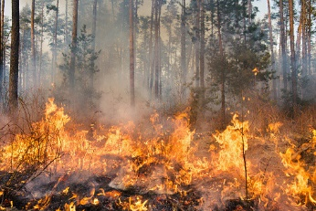

Government Relations
2019-20 Policy Priorities
Protecting first responders and others from occupational exposure to opioids / synthetic analogues
Teen workplace safety education
Cannabis industry worker health and safety
Disaster preparedness and response
Protections for contingent workers
Teen Workplace Health and Safety
Temporary and Contract Workers
Total Worker Exposure
Transportation Safety
Worker Fatigue
Workforce Development
Workplace Violence
Big Data
Cannabis Industry Health and Safety
Disaster Planning, Response, and Recovery
Hazard Banding/OEL Process
Hearing Protection
Opioids in the Workplace
Professional Title Protection
Sensors

Slide 35

NEW! Next Generation Project
Generation Needs Assessment Survey
Expanded CareerAdvantage offerings for Early Career Professionals
Salary/Compensation survey, including professional salary potential and early career salary potential

Slide 36
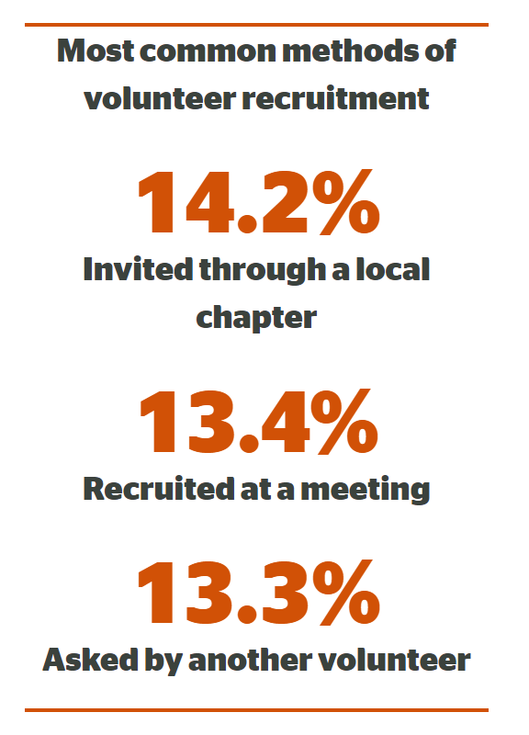

Most Common Methods of Volunteer Recruitment
* ASAE
Notes:
AIHA offers volunteer and leadership development opportunities at the National level through technical, professional development, and operational committees, working groups, tasks forces, etc.
Local Sections and Student Local Sections also offer volunteer and leadership development – each section is unique, so the opportunities do differ from section to section.

Slide 37
VOLUNTEER GROUPS
Technical Committees/Working Groups
Academic Accreditation
ACTIONS (Government Relations)
Aerosol Technology
Biological Monitoring
Biosafety & Environmental Microbiology
Communication & Training Methods
Computer Applications
Confined Spaces
Construction
Environmental Issues
Ergonomics
Exposure & Control Banding
Exposure Assessment
Hazard Prevention & Engineering Controls
Healthcare
Incident Preparedness & Response
Indoor Environmental Quality
International Affairs
Ionizing Radiation
Laboratory Health & Safety
Legal Issues
Leadership & Management
Mining
Nanotechnology
Noise
Nonionizing Radiation
Occupational & Environmental Epidemiology
Oil & Gas
Opioids Responder
Protective Clothing & Equipment
Real-Time Detection Systems
Respiratory Protection
Risk
Safety
Sampling & Laboratory Analysis
Social Concerns
Stewardship & Sustainability
Toxicology
Notes:
Here is a list of our many technical committees and working groups.

Slide 38
VOLUNTEER GROUPS
Professional Development
Career & Employment Service Cmte
Joint Industrial Hygiene Ethics Education Cmte
Mentoring & Professional Development Cmte
Students & Early Career Professionals Cmte
Women in IH (WIH)
Operations
Board of Directors
Conference Program Cmte
Content Portfolio Advisory Group
Continuing Education Cmte
Finance Cmte
Publications Cmte
International Advisory Group
Technology Initiatives Strategic Advisory Group
Special Interest Groups (SIGs)
Academic SIG
Fellows SIG
Minority SIG
AIHF Foundation
Board of Trustees
Scholarship Advisory Cmte
Donor Relations & Fundraising Cmte
Guideline Foundation
Board of Trustees
Emergency Response Planning Cmte
Standards Advisory Panel
Active Volunteers Earn CM Points
Notes:
Note the multiple Advisory Groups (noted under Operations category) – these are filled via an Open Call process. This gives all members an opportunity to volunteer to serve on a more prominent national-level committee. The AIHA Board ultimately approves all appointments, and relies on advisory group counsel.

Slide 39
Benefits/Features for AIHA National Student Members
Value Proposition: Get the experience, connections and career counseling that will position you as THE top candidate for IH/OEHS employers.
Make Connections (Catalyst) | Kickstart Your Career (Career Advantage) | Create Your Path to Success
Members Open Forum Student-Only Community Online Member Directory Resource Libraries Mentor/Mentee Program | Career Counseling Cover Letter/Resume Review Mock Interviewing Career Development Resources Compensation | IH Professional Pathways ™ IH Heroes ™ Career Tracks/Knowledge Areas IAMIH Certification (CIH)
Volunteer to Lead | Keep Informed (Synergist Family) | Help Influence Public Policy (Advocacy Platforms)
Technical Committees/Working Groups Professional Development Student Local Sections Local Sections | Digital Magazine (and archives) NewsWatch Weekly E-News Newswire Newswire News Feed SynergistNOW Blog | Teen Workplace Safety Cannabis Industry Health/Safety Disaster Planning Response and Recovery Contingent/Seasonal and Temporary Workers

Slide 40
Additional Services for AIHA National Student Members
Publications
Digital Journal of Occupational and Environmental Hygiene (JOEH) and archives Essentials of Exposure Assessment (complimentary PDF) Exploring the Dangerous Trades: Alice Hamilton Bio (complimentary pdf/new student members only)
Dedicated Committee Resources
Student and Early Career Professionals Committee Career and Employment Services Committee Mentoring and Professional Development Committee Minority Special Interest Group (SIG)
Special Pricing & Advantages
Member pricing on e-learning and webinars Special student rate for AIHA signature event, AIHce EXP Discounts/Free Shipping of MarketPlace Publications White Papers and Guideline Documents (complimentary) AIHce Sponsorships AIH Foundation Scholarships

Slide 41
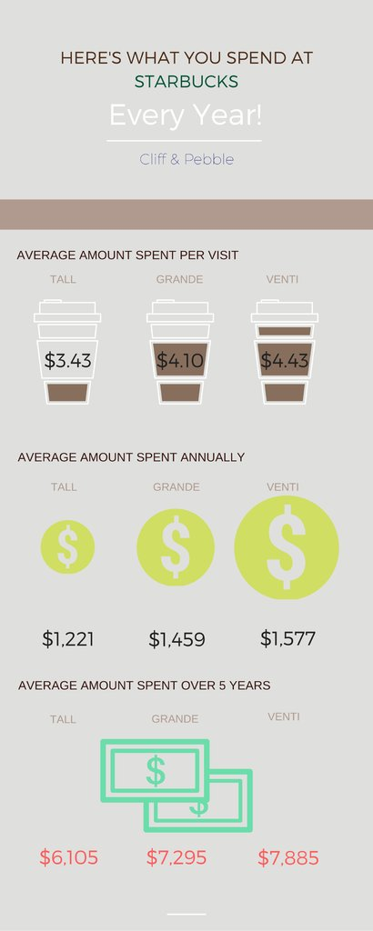
Is a Month of Starbucks More Important than an Investment in Your Future?
On average, people spend between $101 - $131 monthly for Starbucks.
We all know coffee (and related beverages) is the elixir of life and cannot be done without, but, for a lot less more money, you can have a much more sustained “buzz” for the future of your career (without such a caffeine crash afterwards).
Let me show you…
Source: https://cliffandpebble.com/blogs/our-blog/heres-how-much-your-starbucks-habit-costs-you

Slide 42


An Investment in You!
Student Member: $31/yr < per month!
  A full-time student at the college undergraduate or graduate level in the industrial hygiene or occupational and environmental health and safety field, OR
  A part-time student who are taking at least one-half (1/2) the credit hours required for full-time
Early Career Pro Member: $107/yr < per week!
  An individual that has 15 years or less applied work experience within the industrial hygiene, occupational and environmental health and safety, or allied profession.

Slide 43

Join AIHA!
Only $15.50!
New Student Members
https://www.aiha.org/membership/Pages/Join-AIHA.aspx
In addition, you will also receive a complimentary PDF copy of the following:
Essentials of Exposure Assessment III ($19.95 value)
Exploring the Dangerous Trades: The Autobiography of Alice Hamilton, M.D. ($45 value)
Promo Code: STUDENT
Valid Until 6/1/2019

Slide 44





Connect Now!
Look for exclusive AIHA information, updates, and offers
Follow us for important industry news and happenings
Join the discussion with other like-minded professionals
Check out AIHA Network TV, the I AM IH™ video series, and view popular uploads
Get more information at www.aiha.org

Slide 45
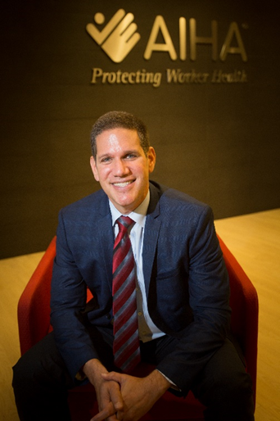
THANKS FOR LISTENING!
Larry Sloan, CEO
Direct: (703) 846-0760
lsloan@aiha.org

